Slide 1
Redux

Slide 2
What is Redux
Redux is a global state management library.
Redux has three major components:
1. Store – A centralized state container that holds the entire application's state.
2. Actions – Plain JavaScript objects that describe an event or intent to change the state.
3. Reducers – Pure functions that take the current state and an action, then return a new state.
A pure function in Redux (or in general programming) is a function that:
1. Always returns the same output for the same input – No randomness or dependence on external variables.
2. Has no side effects – It doesn’t modify external state, make API calls, or mutate data.
3. In Redux, reducers must be pure functions because they take the current state and an action, then return a new state without modifying the existing state.

Slide 3
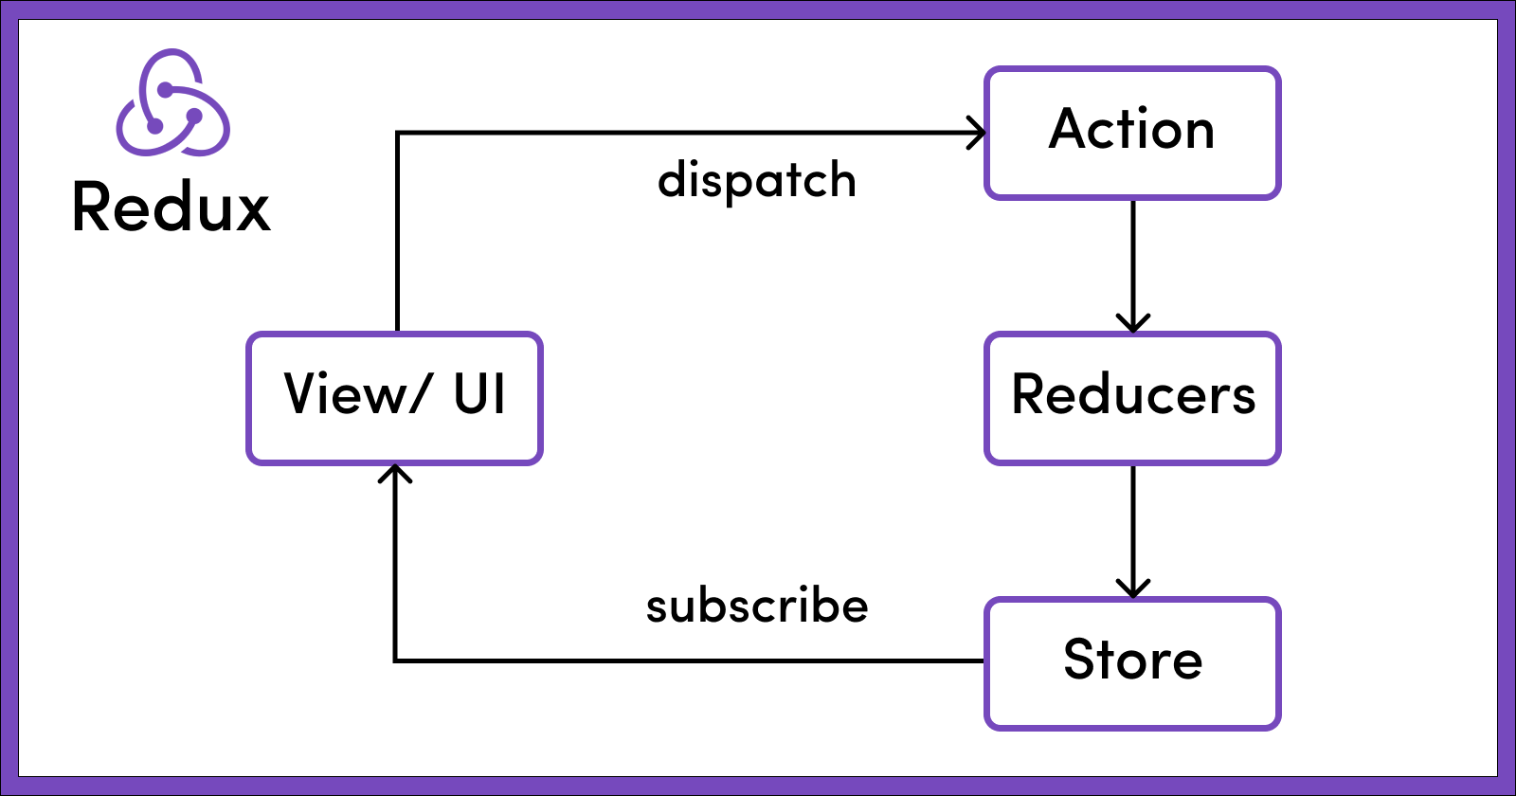

Slide 4
Libraries Required
@reduxjs/toolkit (provides a container to keep the global state)
react-redux (provides hooks to access redux state as well as dispatch actions to redux to update the state in react. This library binds react with redux state.)

Slide 5
Actions and Reducers
In redux, we don’t directly update the state.
Instead, we dispatch an action to redux that tells redux which part of the state to update and how to update:
{ type: “counter/increment”, payload: 3}
The above action instructs redux to increase the value of counter state by 3.
When this action is dispatched, redux will call the reducer responsible for incrementing the value of counter.

Slide 6
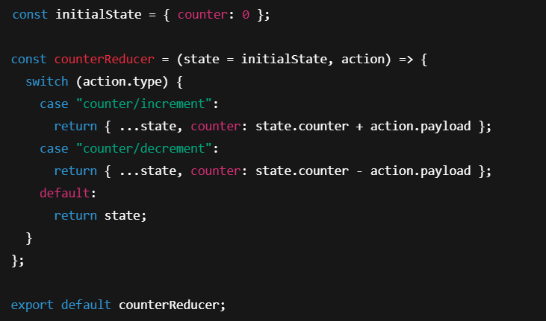
Dispatch an action to redux in react:
Reducer responsible for updating counter state:

Slide 7
Redux only passes the specific part of the state that a reducer is responsible for.
For example, a reducer managing counter will only receive the counter state, not other parts of the global state.
When Redux initializes, it automatically dispatches an @@INIT action, allowing reducers to return their initial state.
On subsequent actions, Redux passes the current state to the reducer instead of the initial state, ensuring updates are applied based on the existing state.

Slide 8
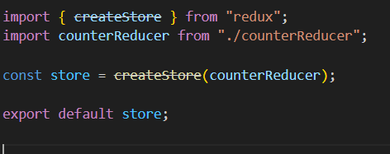
Create a Store in Redux

Slide 9
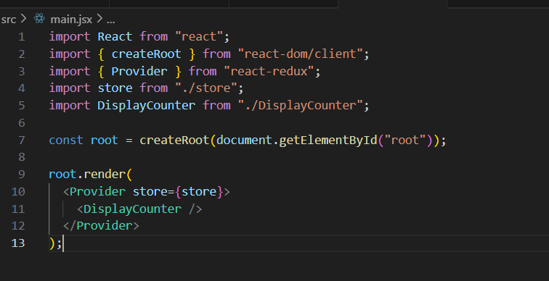
Wrap the App with Redux Store

Slide 10
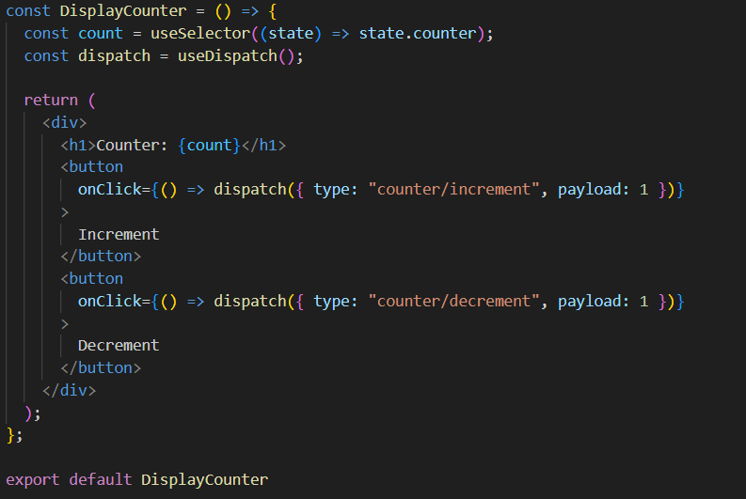
Access and Update Redux State in a Component

Slide 11
The code (mainly reducer and actions) we have discussed so far is for simple redux.
We now have a new and better approach for writing redux logic using redux toolkit.

Slide 12
In redux toolkit, state is made up of slices.
Each slice is responsible for managing the state it contains.
In addition to the state, a slice will also have reducer and actions for updating the state it manages.
A "slice" is a collection of Redux reducer logic and actions for a single feature in your app, typically defined together in a single file. The name comes from splitting up the root Redux state object into multiple "slices" of state.
In a slice, we don’t need to manually create actions since a slice will generate action creators (functions that return an action) for us.
For each subreducer (or case reducer), we will get an action creator of the same name.
We will dispatch the action returned by an action creator which will then call the corresponding case reducer function.
In redux toolkit, we are allowed to mutate the state. Redux will internally convert state mutation into immutable state update using immer library.

Slide 13
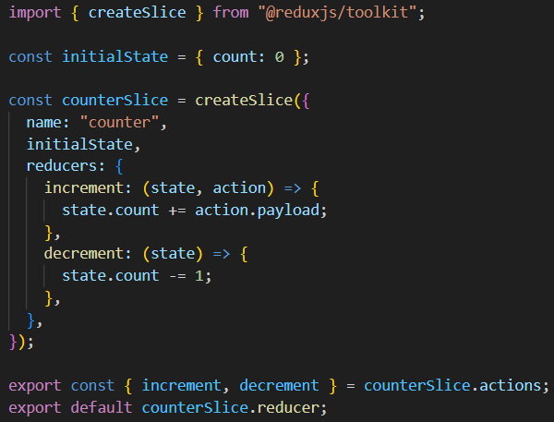
counterSlice.js
increment and decrement are case reducers. For each case reducer, we have
an action creator of the same name.

Slide 14
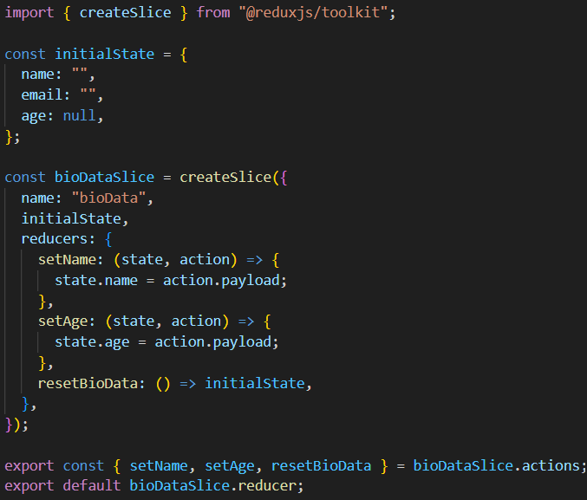
BioDataSlice.js

Slide 15
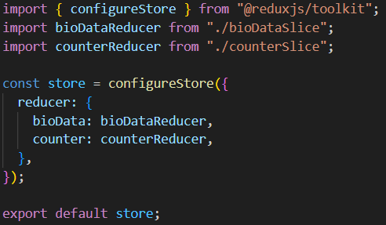
Create Store in Redux toolkit

Slide 16
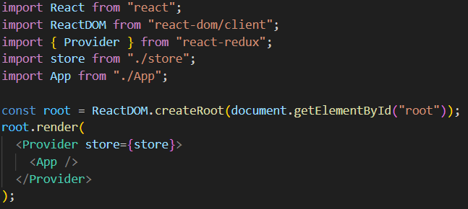
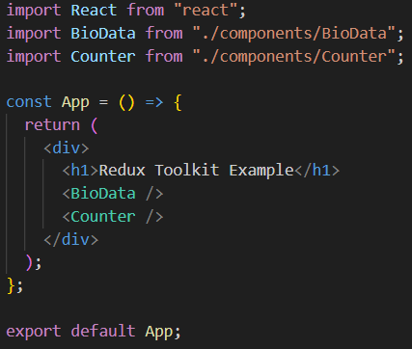
Wrap React App with Redux Store
Main.jsx
App.jsx

Slide 17
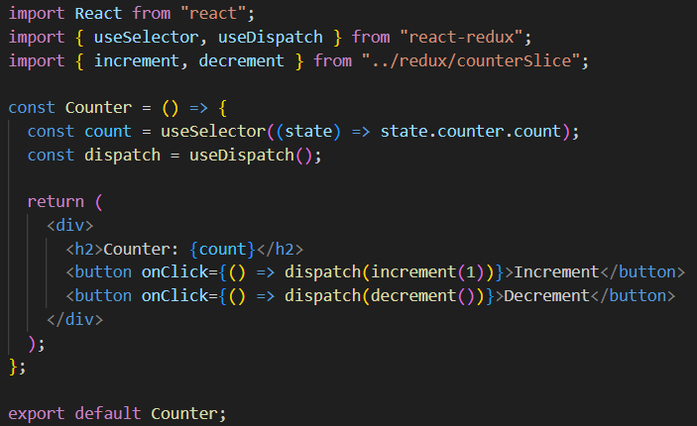
Access and Update Redux toolkit State in a Component
components/Counter.jsx

